Slide 1
Bethpage Public Library
Cash Registers, Printing, Screen Mirroring
ooo the excitement!!
Part II
Rob Sporing, Assistant Director

Slide 2
PC / Mobile Printing

Slide 3
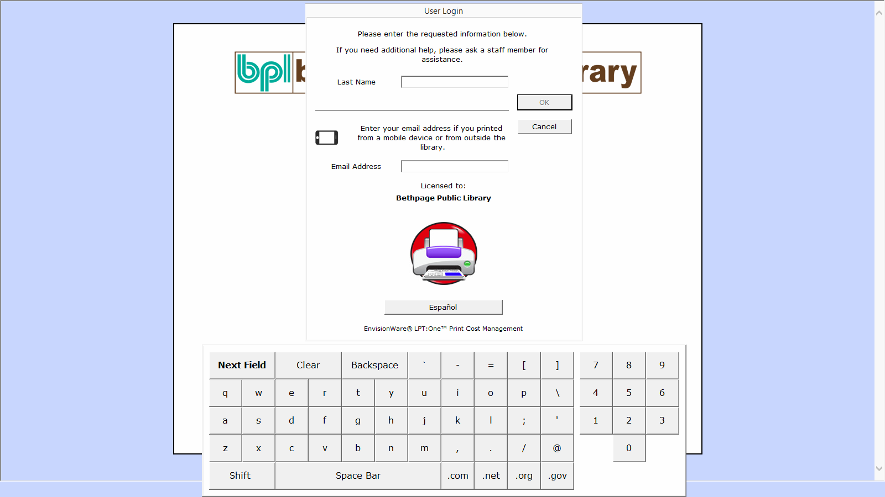
PC / Mobile Printing

Slide 4
PC / Mobile Printing

Slide 5
PC / Mobile Printing

Slide 6
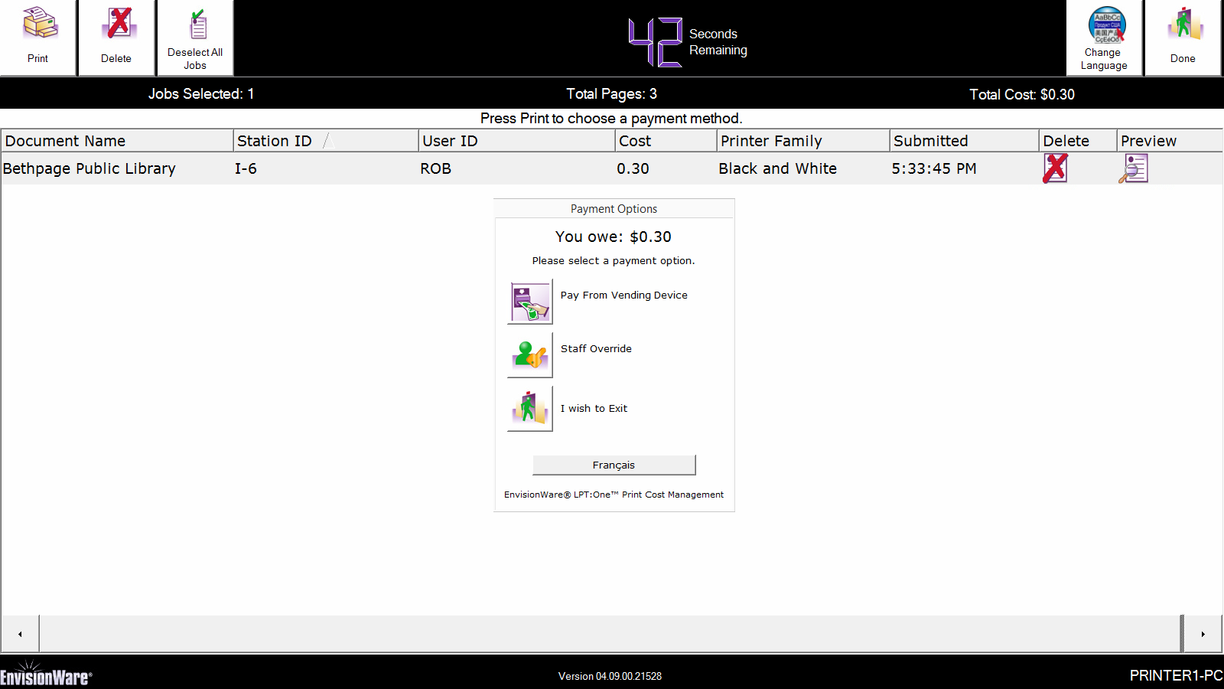
PC / Mobile Printing

Slide 7
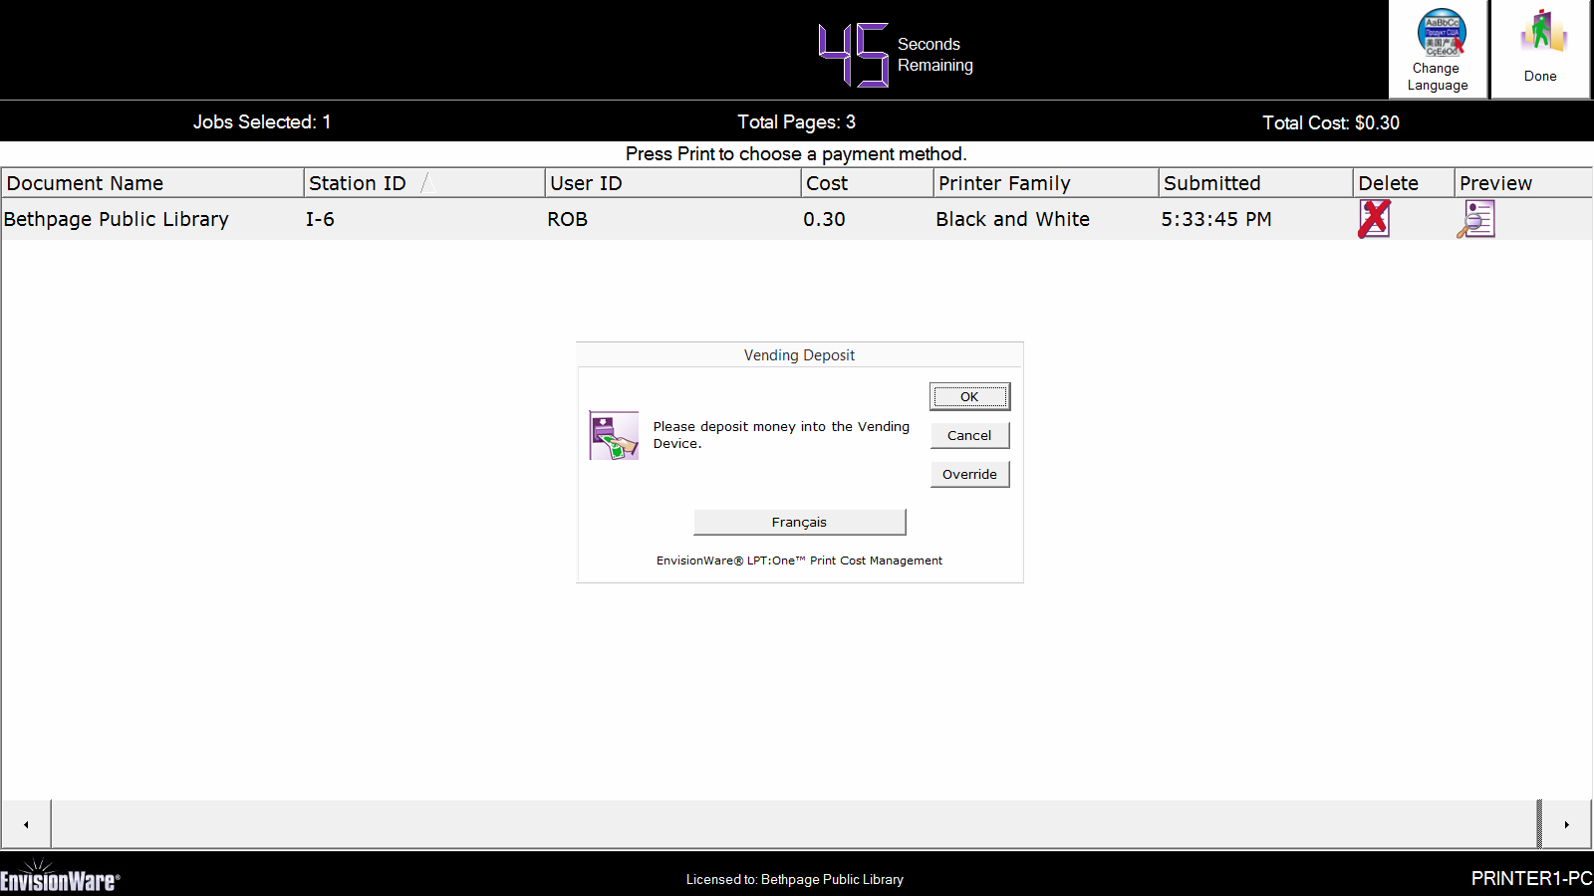
PC / Mobile Printing

Slide 8
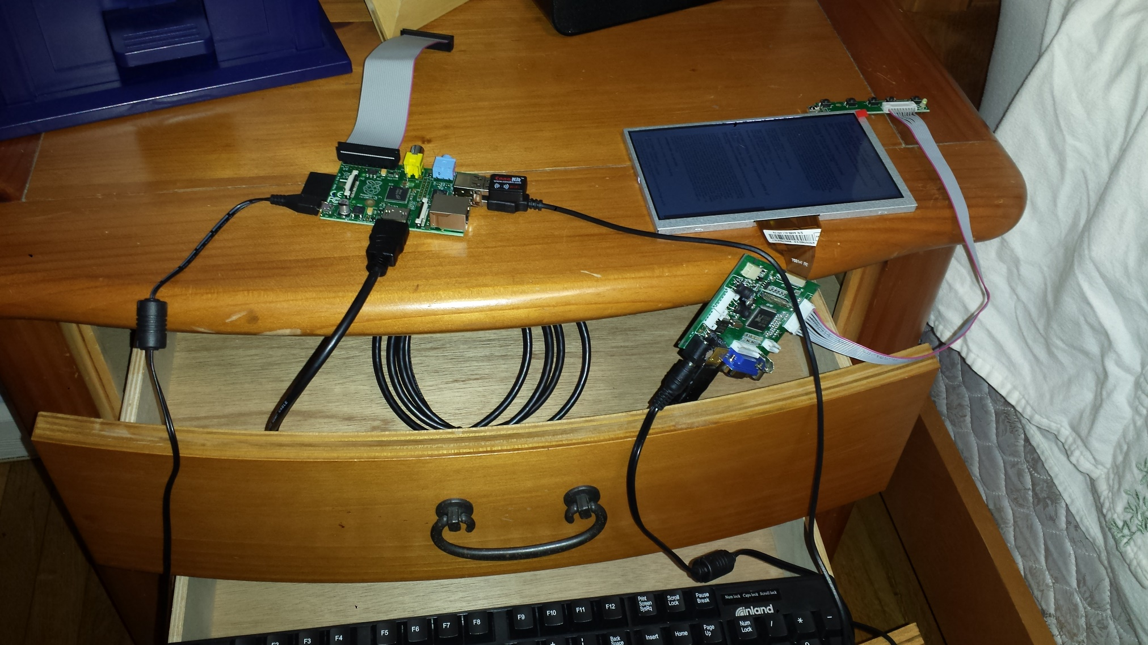
Raspberry Pi Display

Slide 9
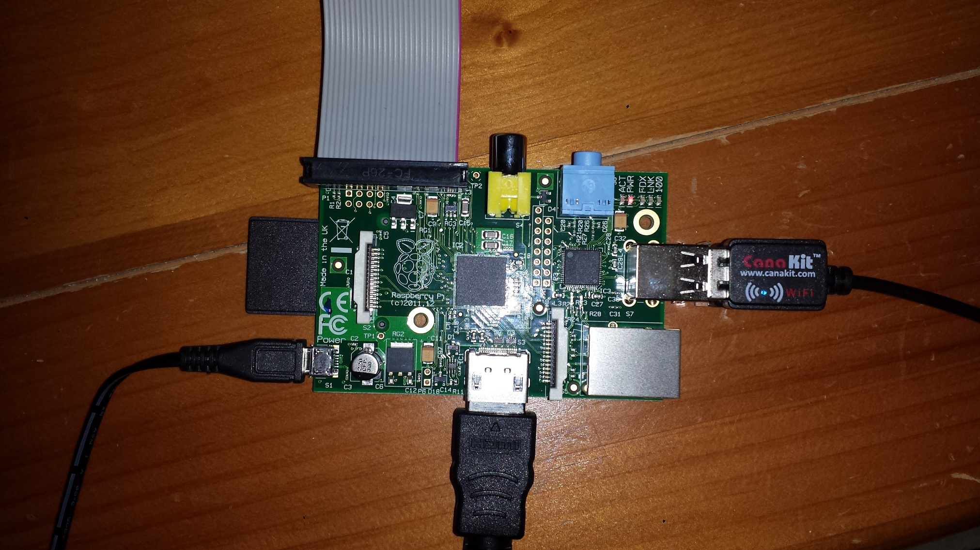
Raspberry Pi

Slide 10
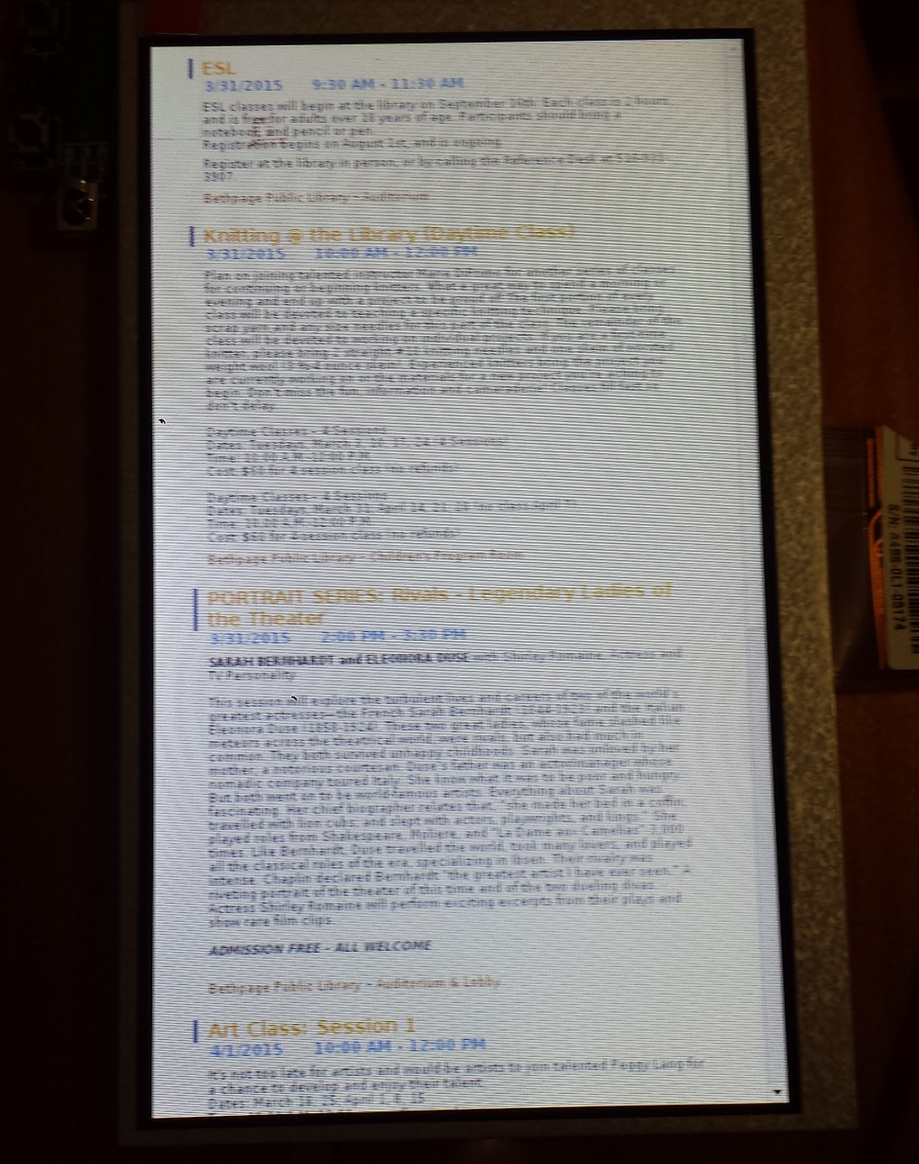
Raspberry Pi Display

Slide 11
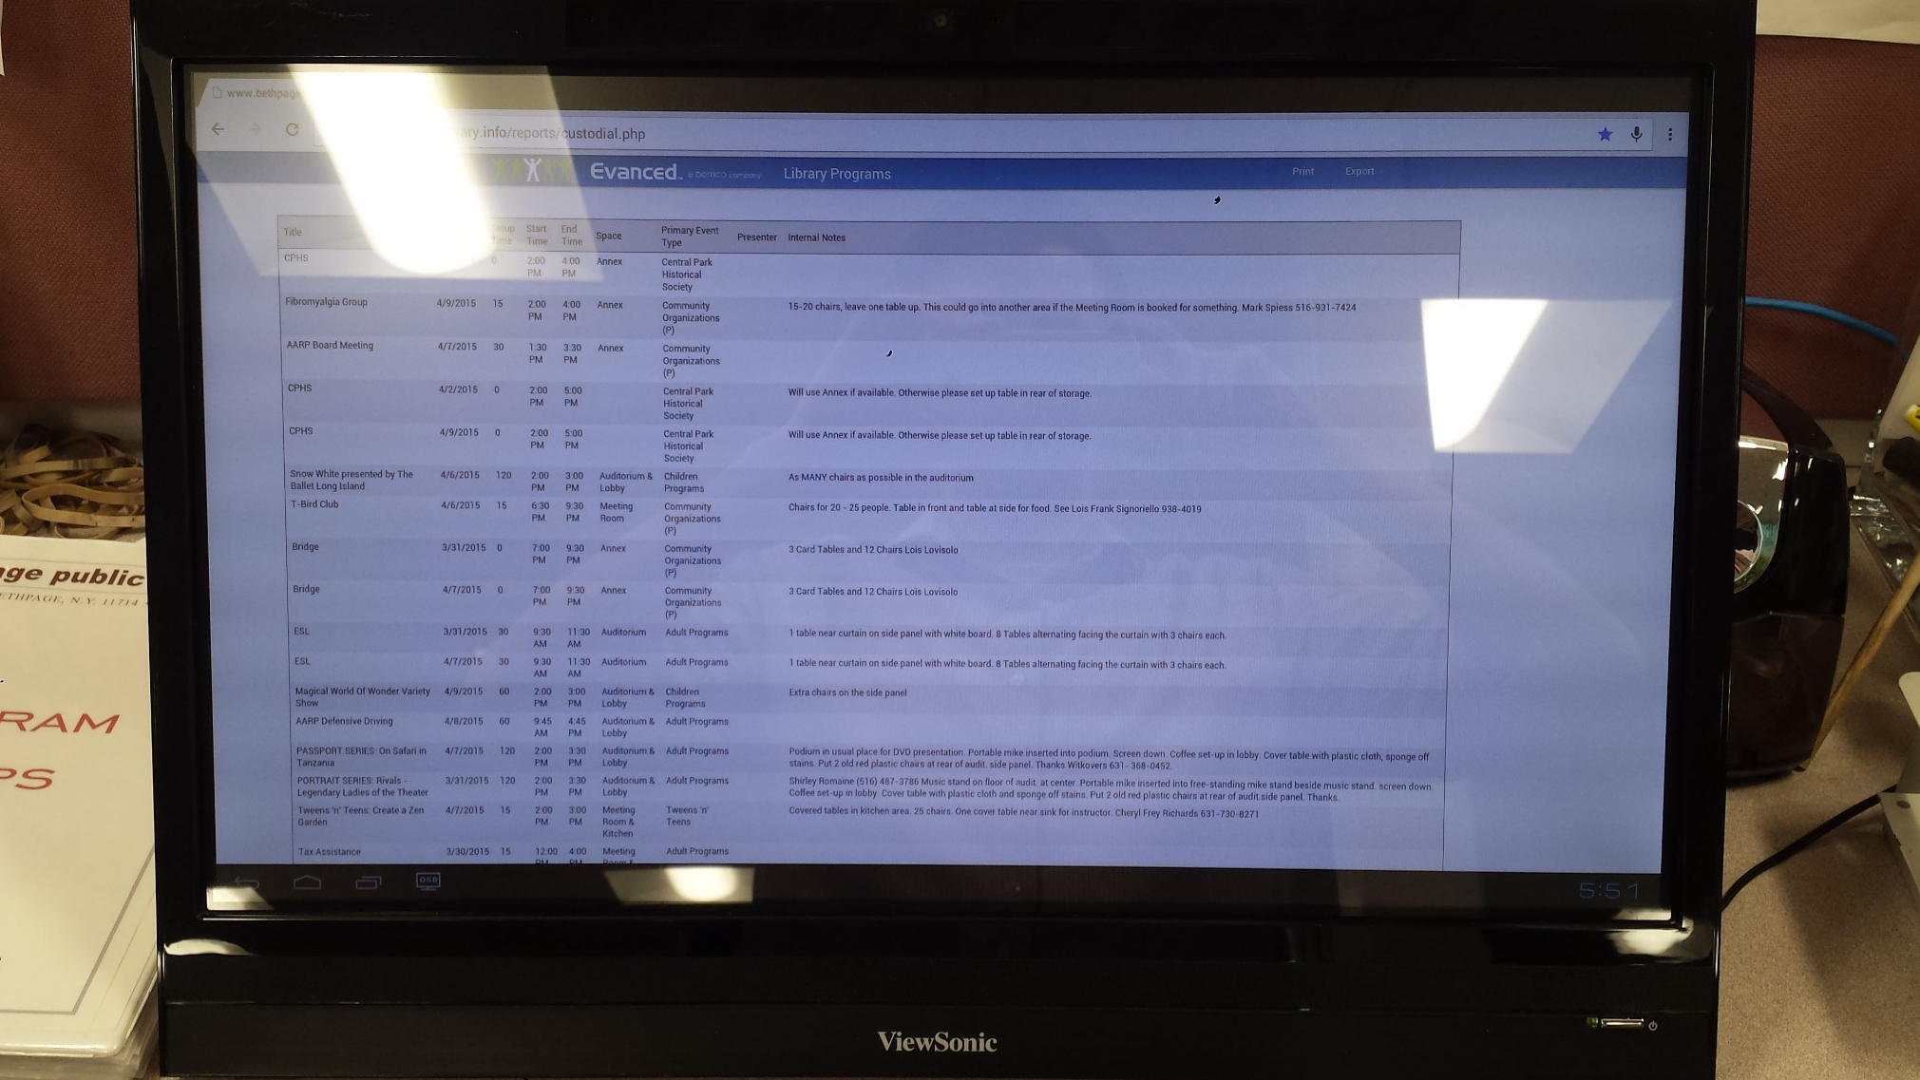
Custodian Calendar

Slide 12
Any More Questions?
Rob Sporing
E-mail: RSporing@bethpagelibrary.info

